Slide 1
Caesarean –when caesarean not needed …

Slide 2
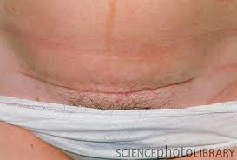
Definition-CS rate
CS rate is defined as the number of caesarean deliveries over the total number of live births, and is usually expressed as a percentage[2]

Slide 3
How is the rate fixed?
minimum necessary CS rate to avoid death and severe morbidity in the mother is 1-5%[5]
Regarding neonatal outcomes, the association of CS rates with neonatal death have shown outcome improvements up to a rate of 10%.
Thus the minimum threshold of CS rate is between 5-10%.[5]

Slide 4
Mortality and morbidity in mothers and neonates does not reduce when CS rate was more than 15%
increased rate was associated with higher levels. for now, rates >15% are not allowed[5]

Slide 5
WHO says, “There is no justification for any region to have CS rates higher than 10-15%”.

Slide 6
Problem statement… What is the rate of CS at present?
WORLD[2]…
Although unevenly distributed, 15% (0.4 – 40.5%) of births worldwide occur by CS.
In developed countries, it is 21.1% (6.2 – 36.0%).
In less developed countries, it is 14.3% (0.4-40.5%).
In least developed countries it is only 2% (0.4-6.0%)

Slide 7
INDIA :
According to the World Health statistics 2012 published by WHO the rate of caesarean section is 9% from 2005 to 2010 [2]

Slide 8
When is a CS done?
NICE clinical guidelines on CS.
Issued: November 2011.
Have also conducted detailed surveys to compare caesarean section and vaginal delivery seen below
Notes:
There are separate guidelines for each and every thing like multiple pregnancy, PIH etc.
National Institute of health and clinical excellence(NICE)

Slide 9
Effects around the time of birth…
Effect | Relative risk(CS compared with vaginal birth)
Reduced after CS…
Perineal Pain | 0.3
Increased after CS…
Abdominal Pain | 1.9
Bladder injury | 36.5
Ureteric injury | 25.2
Need for further surgery such as laparotomy or D&C | 17.5

Slide 10
Effect | Relative risk(CS compared with vaginal birth)
Increased after CS…
Hysterectomy | 44
Admission to ICU | 9.0
Thromboembolic disease | 3.8
Readmission to hospital | 2.5
Maternal Death | 4.9

Slide 11
Effect | Relative risk(CS compared with vaginal birth)
Not different…
Haemorrhage(blood loss in excess of 1000 ml) | 0.8
Infection(Wound infection or endometritis) | 1.3
Genital tract injury (extension of uterine incision, cervical laceration) | 1.2

Slide 12
In the postnatal period…
Reduced after CS…
Urinary incontinence (at 3 months after birth) | 0.6
Utero-vaginal prolapse | 0.6
Not different (at 3 months after birth)…
Faecal incontinence | 0.5
Back pain | 0.9
Postnatal depression | 0.9
Dyspareunia | 0.9

Slide 13
Effects for future pregnancies
Increased after CS…
Having no more children | 1.5
Placenta praevia in a future pregnancy | 1.6
Uterine rupture in a future pregnancy | 42.2
Antepartum still birth in a future pregnancy | 1.6

Slide 14
On Babies’ health…
Complication | Relative risk (CS compared with vaginal delivery)
More likely after a planned CS…
Respiratory morbidity | 6.8
No difference…
Neonatal morbidity | 1.1
Intracranial haemorrhage | 0.6
Brachial plexus injury | 0.5
Cerebral palsy | 0.02

Slide 15
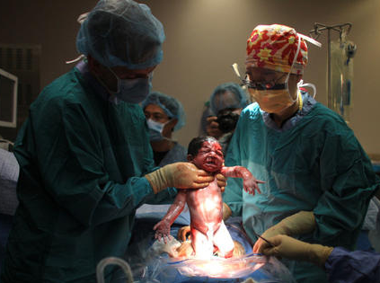
Reasons for the increase…
Women - fewer children- greater percentage of births are among nulliparas- increased risk of CS[5]
Average maternal age
is rising and older
women especially
nullipara -
increased risk of
CS[5,7]

Slide 16
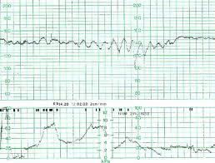
3) Use of Electronic Foetal Monitoring
an increased CS rate compared with intermittent fetal heart rate auscultation.
fetal distress comprises only a minority and in many more cases it is done for a ‘non reassuring’ foetal heart rate tracing.
management based on electronic monitoring is no better in reducing the risk of cerebral palsy or perinatal death than that based on intermittent heart rate auscultation[5]

Slide 17
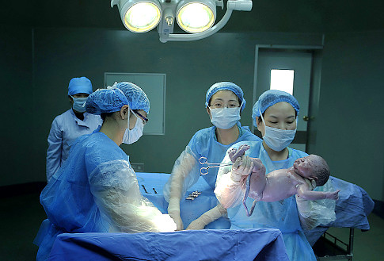
4) Most breech and other abnormal positions or presentations are now delivered by CS[5]
5) Rates of labour
induction
continue to rise
and induced labour
increases
the risk of CS[15]
Notes:
Women who have an uncomplicated singleton breech pregnancy at 36 weeks' gestation should be offered external cephalic version. Exceptions include women in labour and women with a uterine scar or abnormality, fetal compromise, ruptured membranes, vaginal bleeding or medical conditions. [2004] Pregnant women with a singleton breech presentation at term, for whom external cephalic version is contraindicated or has been unsuccessful, should be offered CS because it reduces perinatal mortality and neonatal morbidity. [2004]

Slide 18
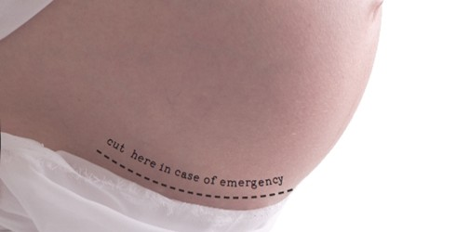
Incidence of forceps and vacuum deliveries has decreased and forceps deliveries are 4 times lesser when compared to vacuum deliveries[13].
Prevalence of obesity has risen dramatically[13] and obesity increases the risk of CS[16].
VBAC has decreased[18].

Slide 19
9) Malpractice Litigation[5]
Contributes significantly to CS
Obstetrics accounts for the largest number of claims paid.
A brain-damaged infant is one of the most prevalent patient conditions among the claims
The average money paid on obstetrical claims was 28 percent greater than for the other specialties.
Notes:
This is especially troubling in view of lack of association between cesarean delivery and any reduction in childhood neurological problems.

Slide 20
10) Caesarean Delivery On maternal Request(CDMR)
Defined as a medically unnecessary CS performed on request by the pregnant patient, irrespective of whether it is a primary CS or repeat CS [6]
Notes:
Also called Maternal Demand for Caesareans(MDCS) or Patient choice caesarean

Slide 21
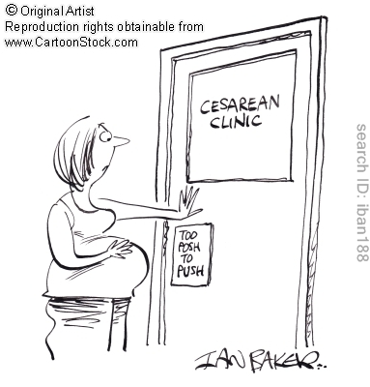
Maternal Choice: “Too Posh to Push”
The various reasons???
1. The Fear factor
2. Can control the exact time
of delivery for auspicious or
other personal reasons[21]
3. Avoidance of the
uncertainty[5]
4. Avoidance of pelvic floor
Injury [5]
Notes:
Assisted caesarean: Naomi Chapman just seconds after using her own hands to give birth to her son, Thomas. australia

Slide 22
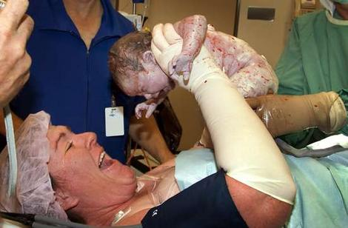
Reduced risk of fetal mortality and morbidity[5,6,10]
Self-doubt on the ability to physically achieve vaginal birth[17]
Think that CS is safer[6]
Convenience[5,10]
Previous unpleasant childbirth experience[17]
Psychological issues related to vaginal delivery[17]

Slide 23
The Fear Factor:-o!!!
Fear Of…
Labour pain[6,21]
Problems arising in labor[6,21]
Pelvic floor injury [6,21]
Damage to the baby during childbirth[17]
Chances of sexual dysfunction[10,21]
Notes:
‘Actress Elizabeth Hurley had one. So did supermodel Claudia Schiffer. Ex-Spice Girl Victoria Beckham and singer Toni Braxton had two each. TV mom Patricia Heaton had four. They’re so popular among the upper class in Brazil that the only way you won’t get one in Rio de Janeiro, as the joke goes, is if your doctor gets stuck in traffic.’ to posh to push
(Time magazine, 2004)
leading to u

Slide 24
Maternal physical factors leading to CDMR…
Advanced maternal age[6]
Multipara[11]
Previous pregnancy
losses[6]
Previous infertility[6]
Pregnancy achieved by
assisted reproduction[6]
Other Health problems[20]
Transmission of perinatal infections such as hepatitis, HIV etc.[21]

Slide 25
What do we say about it?
The switch over to cesarean section is due to various reasons like..
Shortage of human resources[22]
Fear of litigation[10]
Perceived safety of CS[10]
Possess lesser skills
for management of
normal delivery
and its complications[22]
Convenience [22]
Cost[19]
Notes:
5) because vaginal delivery is time consuming, imposes high stress levels and is unpredictable

Slide 26
The well known scenario…
Nearly one fourth of the mothers surveyed in this study who underwent cesarean section reported pressure from medical personnel to have a cesarean[10]
Doctors frequently persuaded their patients to accept a scheduled cesarean section for conditions that either did not exist or did not justify this procedure. The problem identified in this paper is wide spread and should be of concern to those with responsibility for ethical behavior in obstetrics.[12]

Slide 27
The currently available evidence is strongly against a routine elective CS[5]
However, it does ethically support a decision to accept an informed patient’s request for such a delivery[5].

Slide 28
Why shouldn’t it increase?
do not confer additional health gain[2]
increase maternal risks[2,3,4]
implications for future pregnancies[2]
resource implications for health services[2]
elective CS with no emergency presents a 4.9 times greater chance of maternal death than a vaginal birth.
high CS rates may be an indicator for excess maternal mortality in developed countries[3,4,17]
Notes:
This is actually a repetition

Slide 29
Why shouldn’t it increase?
Emergency CS was associated with an almost 9 fold risk of maternal death compared with that of vaginal delivery[5]
Increase in the rates of severe obstetrical complications were associated with the rising CS rate[17,5]
The maternal morbidity rate is increased two fold with CS compared with vaginal delivery. Principal sources are puerperal infection, hemorrhage, and thromboembolism[5,17]

Slide 30
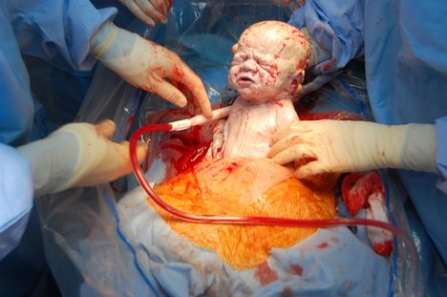
Rehospitalization in the 30 days following CS was twice more common than after vaginal delivery[5]
Due to the morbidities, as well as the increased recovery time, there is a twofold increase in costs for CS versus vaginal delivery [5].
Post natal quality of
life in women after
normal vaginal
delivery is better
when compared to
CS[9]

Slide 31
From the baby’s side…
Increased rate of CS was associated with higher mortality and morbidity in neonates[5]
Higher incidence of respiratory distress and NICU admissions in infants born by CS[10,17].
the incidence of birth asphyxia, trauma, and meconium aspiration is lower in CS[10,17]
Notes:
High incidence of respiratory distress and NICU admissions in infants born by cesarean delivery before the onset of spontaneous labor

Slide 32
The performance of CS per se have no bearing on the neurodevelopmental prognosis of the infant[5]
There is no association between CS and either cerebral palsy or seizures specifically[5]

Slide 33
How can this increase be prevented?
Educating the young doctor population about the dos and don’ts of CS and the various harmful effects if CS rates increase[8]
Conducting detailed enquiry and scrutiny at hospital levels for each and every CS conducted or practice audits[8]
Educating patients[8]

Slide 34
Peer reviewing[5]
Encouraging a trial of labor after prior transverse cesarean delivery[5]
Restricting cesarean deliveries to women who meet strictly defined criteria[5]
A mandatory second opinion was associated with reduction in the cesarean delivery rate[5]

Slide 35
8) Ways to reduce CDMR^{[17]}
Counseling
Antenatal clinics dedicated to reduce CDMR.
Referral to a psychologist
Intensive and continued midwifery support.

Slide 36
If Cesarean Sections are Here to Stay, Can We Make Them Safer?
The conclusions of the ACOG (2007)…
CDMR should not be performed prior to 39 weeks’ gestation unless there is evidence of fetal lung maturity.
Avoided in women desiring several children because of the risk of placenta accreta
Finally, it should not be motivated by the unavailability of effective pain management

Slide 37
"I couldn’t stand the pain anymore. If my baby was going to die, then I decided I would have to die, too. But if he was going to grow up, I was going to see him grow up, and I was going to be with my child. I thought that God would save both our lives."
Notes:
At midnight, on 5 March 2000
Ines Ramírez Pérez is a peasant living in rural Mexico
Son Oriando
Describing her experience, Ramírez said, "I couldn’t stand the pain anymore. If my baby was going to die, then I decided I would have to die, too. But if he was going to grow up, I was going to see him grow up, and I was going to be with my child. I thought that God would save both our lives."^{[1]}
Ramírez is believed to be the only person known to have performed a successful caesarean section on herself. Her case was written up in the March 2004 issue of the International Journal of Gynecology & Obstetrics.^{[2]}

Slide 39
1. CDMR accounts for a great part among the reasons for the increase of CS rate.
MYTH^{[23]}
2. If there is an elective CS scheduled, as a doctor, I have lesser resposnsibilities than when a patient is in labour.
MYTH
3. Most women prefer vaginal delivery over primary CS.
TRUTH^{[23,5]}
4. As a doctor, I need not be familiar with all the skills in conducting a labour because there is always an option of caesarean section or referral.
MYTH
Notes:
I have planned in asking the students what they consider as a myth and they what they consider as a truth based on the things taught so far and a bit extra… and I am planning on correcting them giving the exact details if they are wrong…
I have not given exact references for each because some of them are my derivations of various studies and not the exact content of them

Slide 40
5. There is no specific law against forced caesarean section.
TRUTH
6. Cost of a woman undergoing normal labor and treatment of its various complications associated with the baby and the mother is anyway equal to the cost of a CS.
MYTH^{[19]}
7. In the absence of any obstetrical or other medical complications, CS is desirable than a normal labor.
MYTH^{[17,5etc.]}

Slide 41
8. CS is not associated with better neurodevelopment of the baby.
TRUTH^{[17,5etc.]}
We indian obstetricians have done more CS than what we are expected to do. MYTH
10. This seminar was worth listening to.
HA HA HA???!!!

Slide 42
Take HOSPITAL Message…
Each one of us have a moral obligation towards the patient and the country to keep the caesarean section rates down… So…
Never opt for a CS unless medically or otherwise indicated!
Try to follow the guidelines!

Slide 43
References
Luz Gibbons, Jose M. Belizan, Jeremy A Lauer, Ana P Betran, Mario Merialdi and Fernando Althabe; World Health Organaisation. The global numbers and costs of additionally needed and unnecessary caesarean sections performed per year. World health report. 2010
Ana P Betran, Mario Merialdi, Jeremy A. Lauer, Wang Bing-shun, Jane Thomas, Paul Van Look et al.; World Health Organisation. Rates of caesarean section : analysis of global, regional and national estimates. Paediatric and perinatal epidemiology. 2007; vol 21:98-113

Slide 44
Dobson R. Caesarean section rate in England and Wales hits 21%. BMJ 2001;323:951
Bailey PE, Paxton A. Program note. Using UN process indicators to assess needs in emergency obstetric services. International Journal of Gynaecology and Obstetrics 2002;76:299-305.
Chapter 25 : Caesaren delivery and peripartum hysterectomy. In : F. Gary Cunningham, Kenneth J. Leveno, Steven L. Bloom, John C. Hauth, Dwight J. Rouse, Catherine Y. Spong, editors. William’s Obstetrics , 23rd edition : McGraw-Hill; 2010. p. 544-549

Slide 45
6) Ngozi S Okonkwo, Oladosu A Ojengbede, Imran O Morhason-Bello, and Babatunde O Adedokun. Maternal demand for cesarean section: perception and willingness to request by Nigerian antenatal clients. Int J Womens Health. 2012; 4: 141–148. . PubMed Central PMCID: PMC3325008.
7) Mastaki J Kambale. Social predictors of caesarean section births in Italy. Afr Health Sci. 2011 December; 11(4): 560–565. PMCID: PMC3362978

Slide 46
8) Ma Runmei, Lao Terence T, Sun Yonghu, Xiao Hong, Tian Yuqin, Li Bailuan. Practice audits to reduce caesareans in a tertiary referral hospital in south-western China. Bull World Health Organ. 2012 July 1; 90(7): 488–494. PMCID: PMC3397701
9) Behnaz Torkan, Sousan Parsay, Minoor Lamyian, Anoshirvan Kazemnejad and Ali Montazeri. Postnatal quality of life in women after normal vaginal delivery and caesarean section. BMC Pregnancy Childbirth. 2009; 9: 4. PMCID: PMC2640344
10) Ashwin Ramachandrappa and Lucky Jain. Elective Cesarean Section: It’s Impact on Neonatal Respiratory Outcome. Clin Perinatol. 2008 June; 35(2): 373–vii. PMCID: PMC2453515

Slide 47
11) Agustina Mazzoni, Fernando Althabe, Nancy H Liu, Ana M Bonotti, Luz Gibbons, Alejandro J Sánchez and José M Belizán. Women’s preference for caesarean section: a systematic review and meta-analysis of observational studies. BJOG. 2011 March; 118(4): 391–399. NIHMSID: NIHMS246562
12) Joseph E. Potter, Kristine Hopkins, Anibal Faúndes, Ignez Perpétuo.Women’s Autonomy and Scheduled Cesarean Sections in Brazil: A Cautionary Tale. Birth Volume 35, Issue 1, pages 33–40, March 2008.
13) Unzila A Ali and Errol R Norwitz. Vacuum-Assisted Vaginal Delivery. Rev Obstet Gynecol. 2009 Winter; 2(1): 5–17. PMCID: PMC2672989

Slide 48
14) World Health Organisation. WHO recommendations of induction of labour. Switzerland : WHO press; 2011. p 6.
15) World Health Organisation. Obesity and overweight. Fact sheet N°311 May 2012
16) Michelle A. Kominiarek, Paul VanVeldhuisen,Judith Hibbard, Helain Landy, Shoshana Haberman, Lee Learman. The Maternal Body Mass Index: A Strong Association with Delivery Route. Am J Obstet Gynecol. 2010 September; 203(3): 264.e1–264.e7. PMCID: PMC2933947

Slide 49
17) NICE clinical guidelines on Caesarean Section. Issued: November 2011. Available from : http://publications.nice.org.uk/caesarean-section-cg132
18) William A. Grobman, Yinglei Lai, Mark B. Landon, Catherine Y. Spong, Dwight J. Rouse. The change in the VBAC Rate: An Epidemiologic Analysis. Paediat Perinat Epidemiol. 2011 January; 25(1): 37–43. PMCID: PMC3066476
19) Jostein Grytten, Lars Monkerud, Terje P Hagen, Rune Sørensen, Anne Eskild and Irene Skau. The impact of hospital revenue on the increase in Caesarean sections in Norway. A panel data analysis of hospitals 1976-2005. BMC Health Serv Res. 2011; 11: 267. PMCID: PMC3210106

Slide 50
20)Kuei-Hui Chu, Chen-Jei Tai, Chun-Sen Hsu, Mei-Chiang Yeh and Li-Yin Chien. Women's preference for cesarean delivery and differences between Taiwanese women undergoing different modes of delivery. BMC Health Serv Res. 2010; 10: 138. PMCID: PMC2885388
21) Louise Duperron. Should patients be entitled to cesarean section on demand? YES. Can Fam Physician. 2011 November; 57(11): 1246–1248. PMCID: PMC3215597
22) Bahareh Yazdizadeh, Saharnaz Nedjat, Kazem Mohammad, Arash Rashidian, Nasrin Changizi and Reza Majdzadeh. Cesarean section rate in Iran, multidimensional approaches for behavioral change of providers: a qualitative study. BMC Health Serv Res. 2011; 11: 159. PMCID: PMC3146409

Slide 51
23) Childbirth connections.org[Internet]. New York: Childbirth Connection, October 2006. Available from : http://www.childbirthconnection.org/article.asp?ClickedLink=274&ck=10168&area=27

Slide 52
Thank You!!!
Notes:
Introduction of the transverse incision technique to minimize bleeding by Ferdinand Adolf Kehrer in 1881 is thought to be first modern CS performed.
the first recorded incidence of a woman surviving a Caesarean section was in the 1580s, in Siegershausen, Switzerland: Jakob Nufer, a pig gelder, is supposed to have performed the operation on his wife after a prolonged labour.
Vbac 2nd CS risk
Headings
Male or female obs
Cost

